Slide 1
Project Title:
Al-Enhanced Career Guidance System for Personalized Career Pathways.
CSE7101- Capstone Project
Review-5
Batch Number: ISE_37
Under the Supervision of,
Mr. JaiKumar
Assistant Professor
School of Computer Science and Engineering
Presidency University,
Bangalore
Roll Number | Student Name
20221ISE0151 20221ISE0132 20221ISE0125 | Shreyas G Gowda Amoolya P N Soujanya Oralagi
Name of the Program: ISE
Name of the HoD: Dr. Zafar Ali Khan N
Name of the Program Project Coordinator: Ms. Suma N G
Name of the School Project Coordinators: Dr. Sampath A K , Dr. Geetha A

Slide 2
Problem Statement Number: PSCS_470
Organization : AI-enhanced Smart Education
Category : Software
“AI-powered career guidance software platform that provides personalized career
pathways using aptitude analysis, skill gap detection, and predictive forecasting.”
Problem Description:
The AI-powered career guidance system is designed to provide personalized career pathways for students and professionals by analysing their aptitude, aspirations, abilities, and work experience. Unlike traditional counselling, it leverages AI-driven assessments and predictive analytics to recommend tailored career options, highlight future progression opportunities, and suggest targeted learning to fill skill gaps. With an intuitive and user-friendly interface, the system ensures that individuals at any stage— whether exploring initial choices or considering a career shift—receive data-driven, future-oriented guidance aligned with their unique profile and long-term goals.

Slide 3
Objectives
Provide AI-powered personalized career guidance..
Assess students aptitude and skills for career mapping .
Identify skill gaps and suggest targeted learning resources.
Deliver holistic education, upskilling and career growth recommendation,
Track student progress and give continuous career guidance updates.

Slide 4
Background and Related work for title Selection
Traditional career counseling methods are generic and lack personalization.
Existing tools rely on static aptitude tests with limited adaptability.
Rapid industry changes create a gap between students skills and job demands.
AI and data analytics enable personalized and predictive career guidance.
Growing demand for adaptive career systems due to rapidly changing job markets.
Helps students make informed decisions and reduce career mismatches.

Slide 5
EVALUATION AND RESULTS
1. Test Environment
Local machine specs
Software stack
Offline inference testing
2. Testing Methodology
Black-box testing
White-box testing
User-centric testing
AI output evaluation

Slide 6
Analysis of Problem Statement
3. Test Cases & Results
Registration test
Onboarding test
Dashboard generation test
Chat personalization test
Profile editing test
Offline mode test
4. Performance Evaluation
Dashboard AI response time: 3–8 sec
Chat response time: 1–4 sec
AI recommendation scoring table

Slide 7
5. Usability Evaluation
User feedback summary (pg 71)
92% onboarding ease
88% guidance helpful
100% valued offline privacy
6. Security Evaluation
Hashed credentials
Zero cloud dependency
Sanitized prompts

Slide 8
7. Social, Ethical, Legal and Sustainability Aspects
Social impact: accessibility, inclusiveness
Legal: GDPR compliance via local storage
Ethical: non-biased recommendations
Sustainable: low carbon footprint (no cloud load)
Safety: psychological safety, harmless responses
8. Future Enhancements
Resume parsing
Job-API integration
Voice-based guidance
Advanced psychometric analysis
Analytics dashboard for institutions

Slide 9
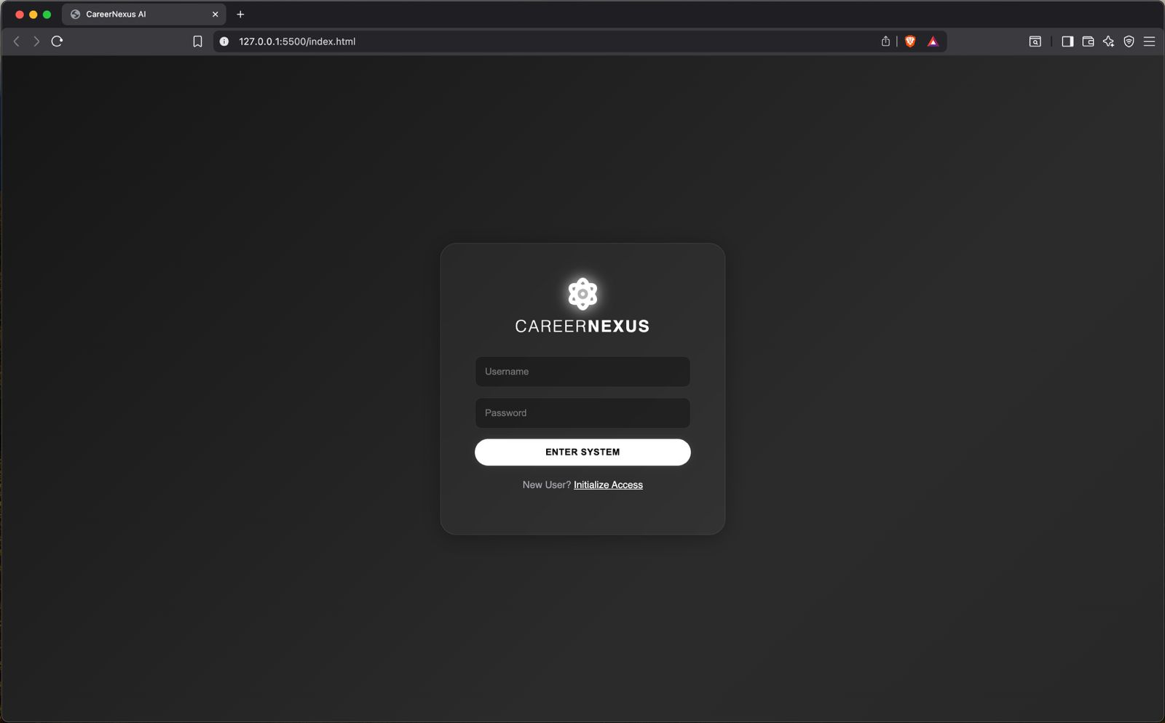
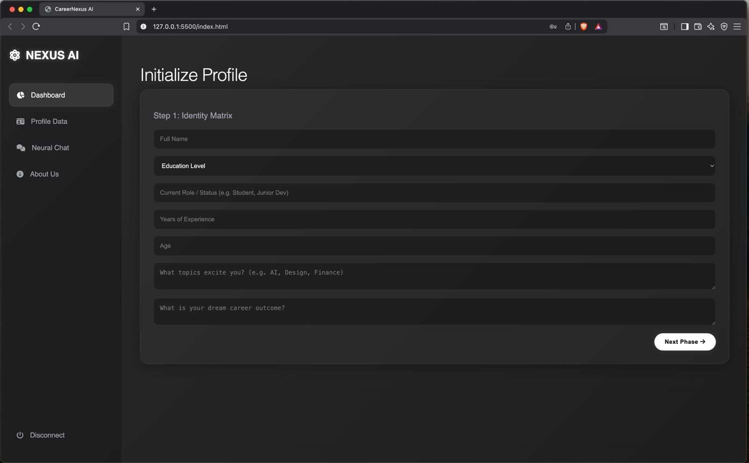
Demo Pictures of The Project

Slide 10
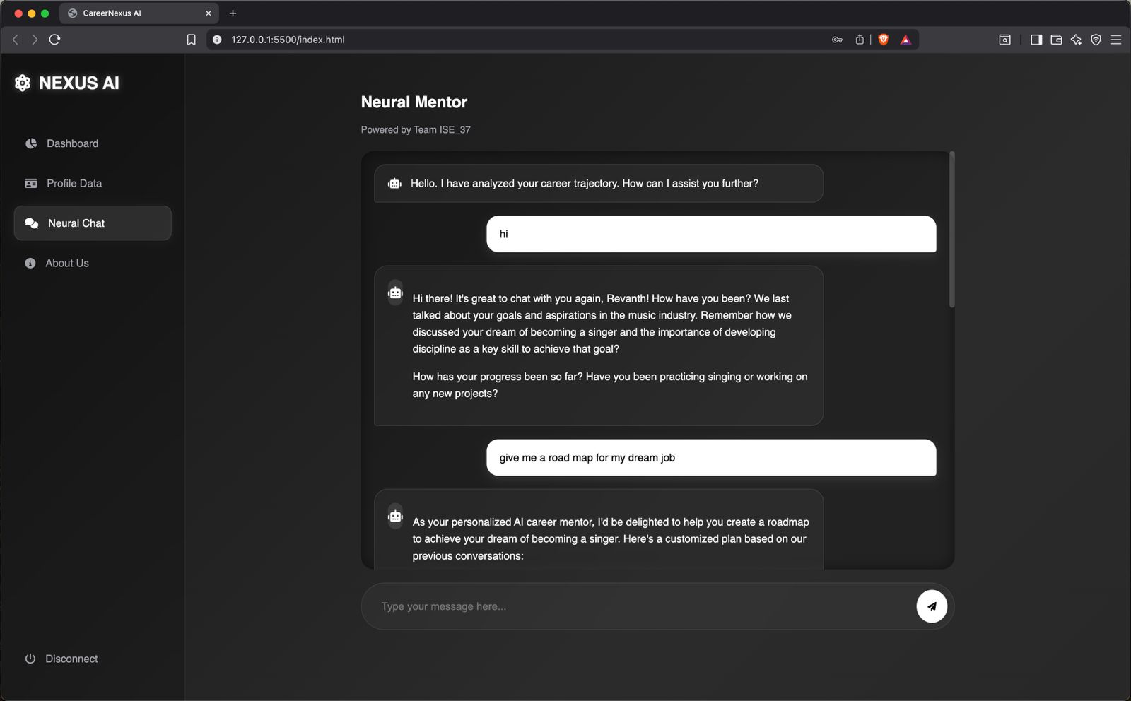
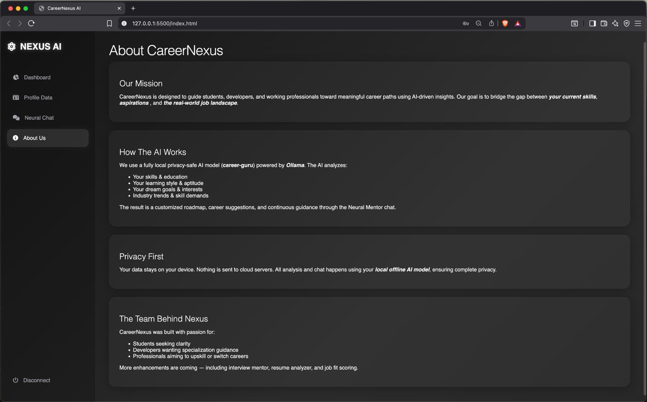

Slide 11
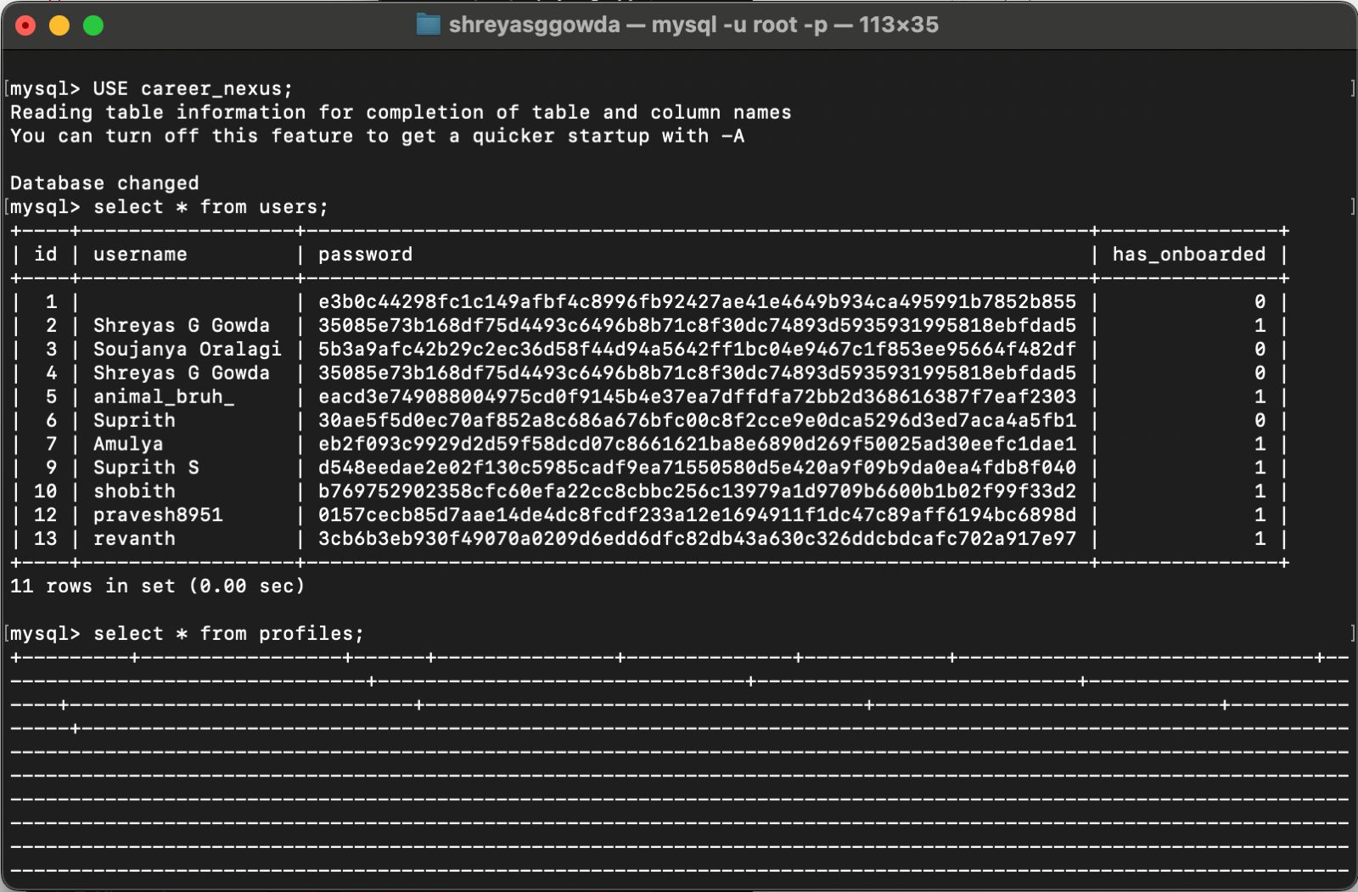

Slide 12
Github Link
Github Link:
shreyasggowda/career_nexus

Slide 13
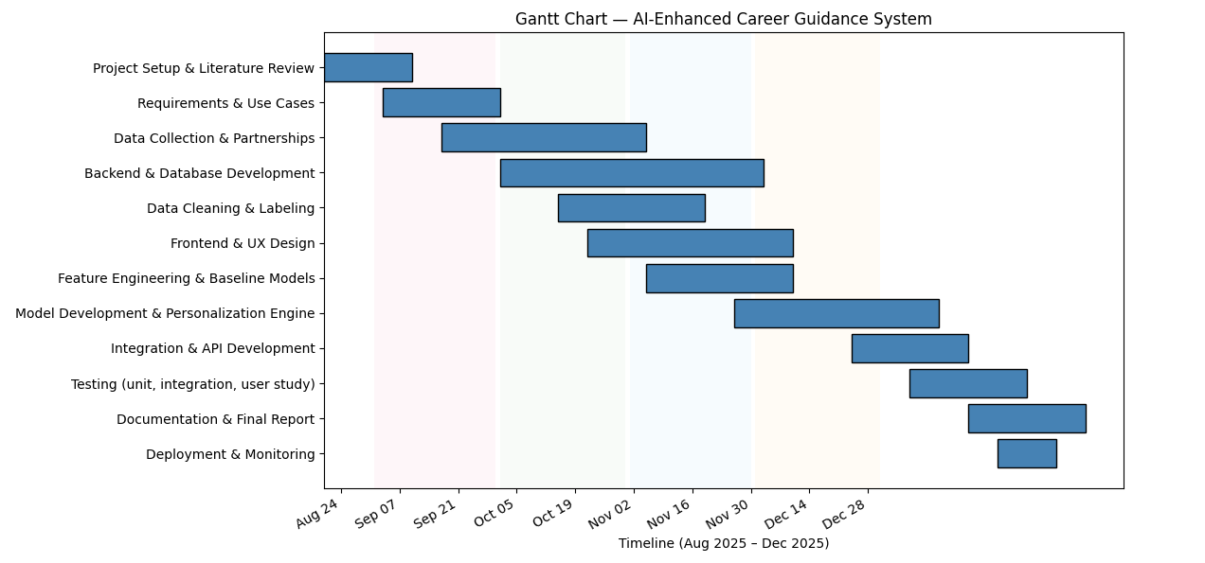
Timeline of the Project (Gantt Chart)

Slide 14
References (IEEE Papers)
[1] Y. Huang, “Individualized career planning intelligent teaching system for college students based on adaptive artificial intelligence,” Journal of Intelligent & Fuzzy Systems, vol. 48, no. 2, pp. 1787–1797, 2025.
[2] V. Vignesh, N. Praveen, and R. Rajesh, “An Intelligent Career Guidance System using Machine Learning,” in Proc. Int. Conf. on Computing and Communication Technologies (ICCCT), 2021, pp. 1–6.
[3] J. Jaspin and A. S. Kannan, “AI Assisted Career Guidance and Resume Screening System,” in Proc. 2024 Int. Conf. on Smart Systems and Inventive Technology (ICSSIT), 2024, pp. 1462–1469.

Slide 15


